Slide 1
Introduction to Behavioural Economics
Dr.R.Gayathri
Faculty,SoM,SASTRA

Slide 2

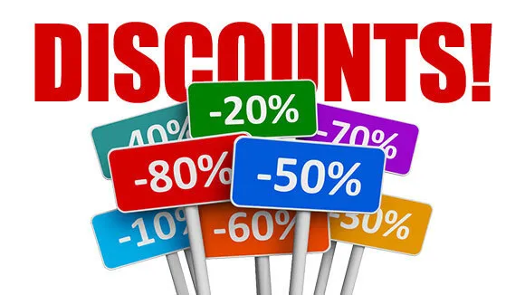
A few examples ..,

Slide 3


Slide 4


How many of us read messages while we drive?

Slide 5
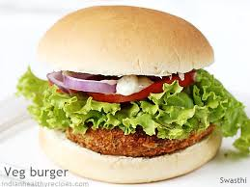
How do you respond?
Behaviour economics – Humans - Automatic system
Unconscious , fast and effortless, gut reaction ,often irrational

Slide 6

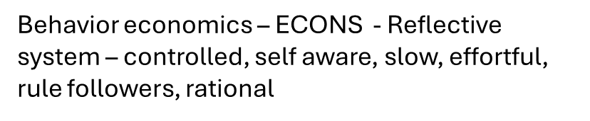
How do you respond?

Slide 7
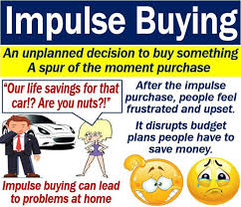

Impulsive buying

Slide 8
Principles of Behavioural Economics
The Power of Free – Ex. Offers
Social Proof – Social media reviews – Ex. feedback
Scarcity – product is lesser in supply – Ex. Starbucks
Loss aversion - highlight what they are set to lose if they don’t make a purchasing decision. Ex. Amazon’s deals
Partial ownership - free trials – Ex. Adobe, antivirus software
Framing - framing is highlighting unique aspects of the product . Ex.Tesla
Dominated alternative/ Third Decoy – More expensive options may be better . Ex – recharge packs with more no. of days
The choice paradox – too many choices to the consumer – Ex: four or five options
Anchoring - we give greater weight to the first piece of information we encounter Ex: Diamonds

Slide 9
How rational are the choices?
Bill is 34 years old. He is intelligent, but unimaginative, compulsive, and generally lifeless. In school, he was strong in mathematics but weak in social studies and humanities.
Rank the following eight statements from most probable to least probable:
Bill is a physician who plays poker for a hobby.
Bill is an architect.
Bill is an accountant.
Bill plays jazz for a hobby.
Bill surfs for a hobby.
Bill is a reporter.
Bill is an accountant who plays jazz for a hobby.
Bill climbs mountains for a hobby.

Slide 10
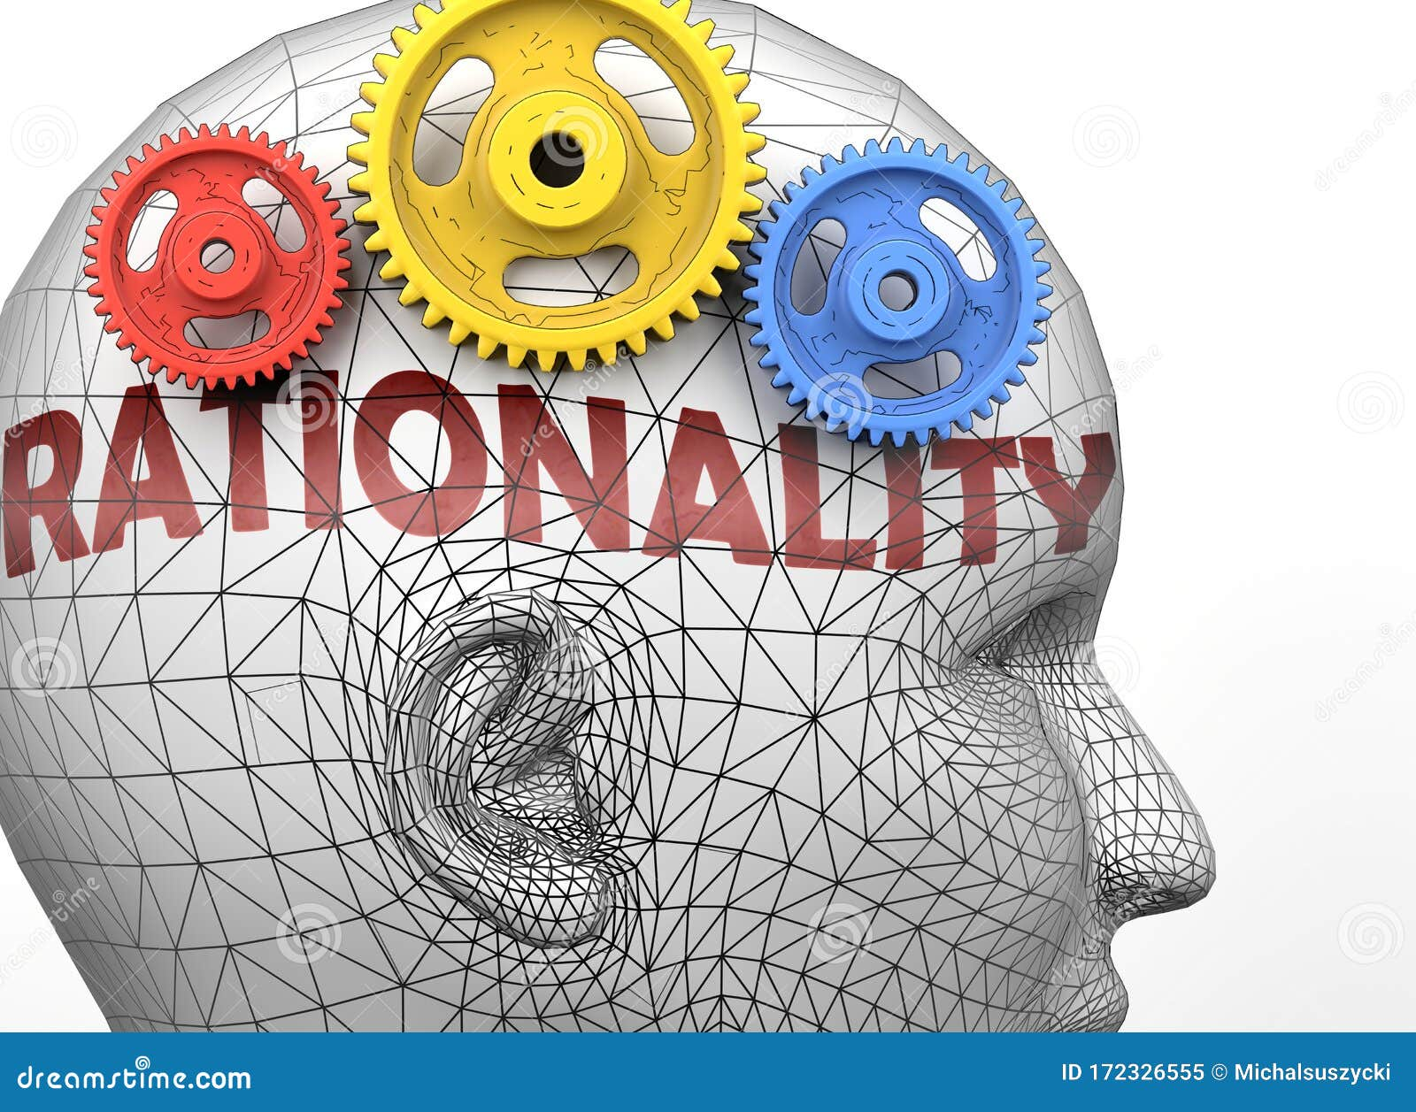
Rational behaviour
Rationality is the quality of being guided by reasons or being reasonable.

Slide 11
What can we invest on?
Invest in human capital- for ex. Education, skill enhancement etc
01
Invest in financial capital – for ex. Insurance, credit, stocks etc
02
Invest in social capital – for ex. – children, family, friends etc
03
Invest in health capital – for ex – nutrition, exercise etc
04

Slide 12
Origin of behavioural economics theory
Notable individuals in the study of behavioral economics include Nobel laureates Gary Becker (motives, consumer mistakes; 1992), Herbert Simon (bounded rationality; 1978), Daniel Kahneman (illusion of validity, anchoring bias; 2002), George Akerlof (procrastination; 2001), and Richard H. Thaler (nudging, 2017).
Companies use information from behavioral economics to price their goods, craft their commercials, and package their products.

Slide 13
Behavioural Economics
Behavioral economics is about understanding economic behavior and its consequences. It’s also about understanding whether people make good or bad choices, and could be helped to make better choices.
Behavioral economics is about testing the standard economic model on humans, seeing when it works and when it does not, and asking whether it can be tweaked or overhauled to improve what we observe.
Behavioral economics is about applying insights from laboratory experiments, psychology, and other social sciences in economics.

Slide 14
Behavioral economics is about working constructively with the standard economic model to get a better understanding of economic behavior.
Behavioral Economics integrates psychological insights into human behavior to explain economic decision-making. It challenges the assumption of fully rational agents in traditional economics.

Slide 15
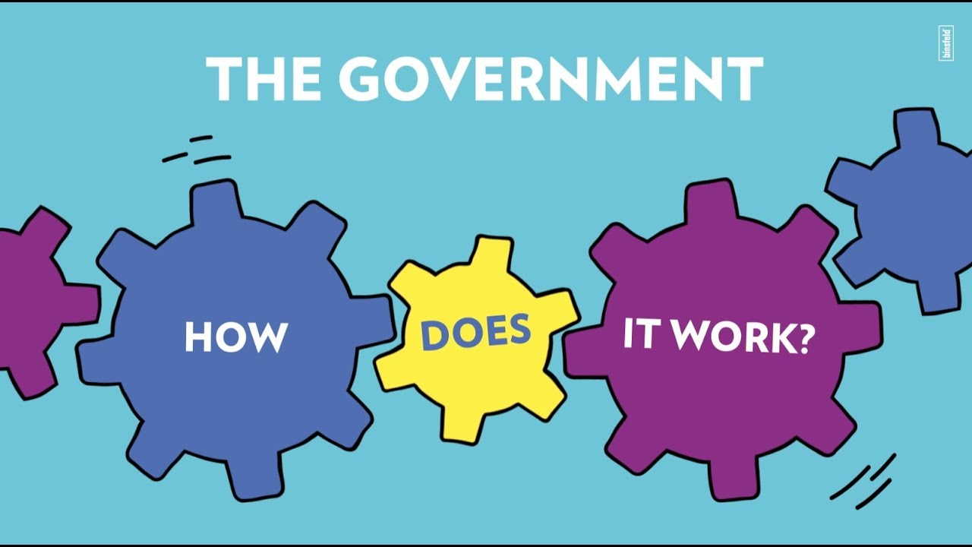

Slide 16
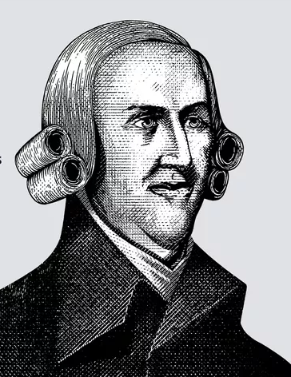
Invisible hand
The term "invisible hand" first appeared in Adam Smith's famous work "The Wealth of Nations" to describe how free markets can motivate individuals, acting in their own self-interest, to produce what is societally necessary.
Adam Smith introduced the concept in his 1759 book "The Theory of Moral Sentiments" and later in his 1776 book "An Inquiry Into the Nature and Causes of the Wealth of Nations."

Slide 17
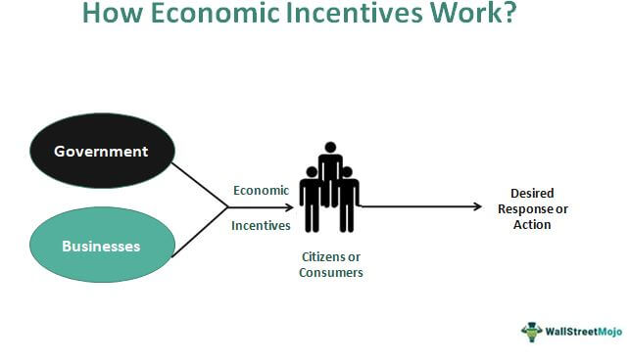
Economic Incentives
Economic incentives are financial rewards provided to people to alter consumption and production patterns in an economy.
The main purpose of the economic incentives approach is to influence human behavior to produce desired results naturally. It is a type of monetary motivation that the government or businesses offer. These can be in the form of money, bonuses, tax rebates, or subsidies.

Slide 18
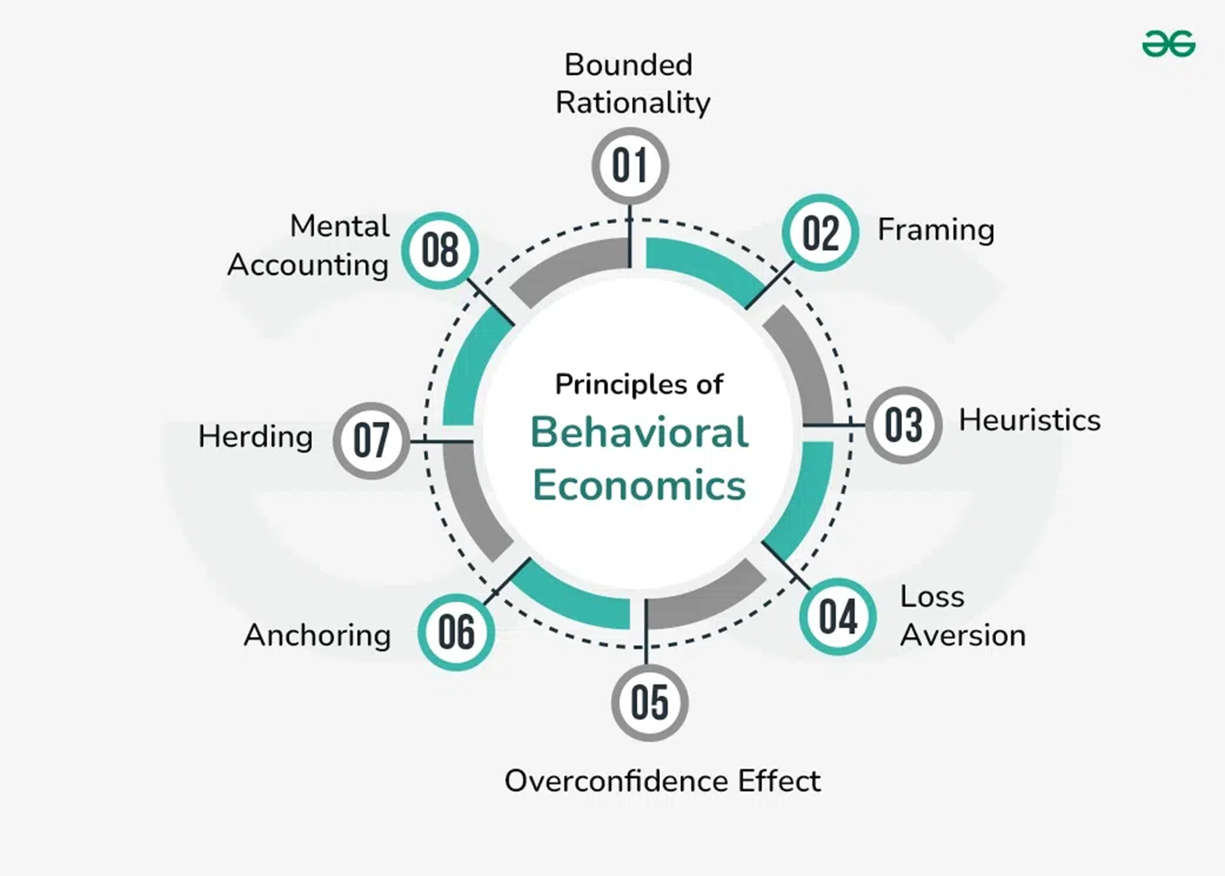
Common Concepts in Behavioural Economics

Slide 19
Bounded Rationality - Humans make decisions within the constraints of limited information and cognitive capacity. This concept, introduced by Herbert A. Simon, suggests that individuals settle for satisfactory solutions rather than optimal ones.
Heuristics and Biases- Mental shortcuts or rules of thumb that often lead to systematic errors in judgment. Amos Tversky and Daniel Kahneman's research identified several biases, such as availability and representativeness heuristics, that affect decision-making.

Slide 20
Framing: Framing effect proposes that individuals make decisions based on how an issue is presented, or “framed,” rather than on the facts presented. It is a cognitive default to choose an option that is more positively presented or framed.
For ex: There is a 70% chance of success, and the shares are expected to go up by 45% on the first trading day.
There is only a 30% chance of failure, but if the IPO succeeds, then the stock price may scale up by almost 45%.
Over confidence effect: Overconfidence bias is a cognitive bias in which individuals tend to overestimate their abilities, knowledge, and skill in a particular area, leading them to make errors in judgment and decision making. This overestimation can manifest itself in various ways, such as an inflated sense of control, unrealistic optimism, or underestimating the risk involved in a situation.

Slide 21
Anchoring is a cognitive bias in behavioral economics that describes the tendency to rely too heavily on the first piece of information offered when making decisions. The concept is part of the field of behavioral finance, which studies how emotions and other extraneous factors influence economic choices.
Herd behavior in humans is a social behavior that is caused when individuals subjugate their individual will, thoughts, and behaviors to the majority, the group, or herd.
Mental accounting is a concept in the field of behavioral economics. Developed by economist Richard H. Thaler, it contends that individuals classify funds differently and are therefore prone to irrational decision-making in their spending and investment behavior.

Slide 22

Loss Aversion and Prospect Theory- People tend to prefer avoiding losses over acquiring equivalent gains. Prospect Theory, developed by Kahneman and Tversky, describes how individuals evaluate potential losses and gains, leading to decisions that deviate from expected utility theory.
Loss Aversion, a key element of Prospect Theory, reveals that people experience losses more intensely than gains of the same magnitude. This can lead to risk-averse behavior, such as holding onto losing investments to avoid realizing a loss, contrary to rational financial decision-making.

Slide 23
Traditional Economics
Traditional economics focuses on early theories of how economies function, rooted in classical economics.
Foundations: Based on the ideas of Adam Smith, David Ricardo, and John Stuart Mill.
Key Concept: Invisible Hand – markets are self-regulating, and individual pursuit of self-interest leads to societal benefits.
Assumptions: Economic agents are rational and aim to maximize utility (for consumers) or profit (for firms).Perfect competition exists in markets. Supply and demand determine prices. Minimal government intervention is preferred (laissez-faire approach).
Focus Areas:Division of labor and productivity (Adam Smith).Labor theory of value and comparative advantage in trade (David Ricardo).
Criticism: Limited in explaining real-world complexities like market failures, externalities, and irrational behavior.

Slide 24
Neo-Classical Economics
Neoclassical economics builds upon traditional economics by introducing mathematical modeling and a focus on individual decision-making.
Foundations: Emerged in the late 19th century with economists like Alfred Marshall, William Jevons, and Léon Walras.
Key Concept: Marginalism – decision-making is based on marginal utility and marginal costs.
Assumptions:
Individuals have rational preferences and act to maximize utility (consumers) or profit (firms).
Individuals have access to complete information.
Markets are efficient and tend to equilibrium (market clearing).
Mathematical Models:
Uses calculus and optimization to model decision-making.
Supply and demand curves are central tools.
Policy Implications:
Advocates for market-based solutions and minimal government intervention.
Emphasizes efficiency and welfare economics (Pareto Efficiency).
Criticism: Fails to account for psychological, cultural, and social influences on decision-making. Assumes unrealistic levels of rationality and information.

Slide 25
Behavioral economics
Behavioral economics challenges the assumptions of traditional and neoclassical economics by incorporating insights from psychology and sociology.
Foundations: Pioneered by Daniel Kahneman, Amos Tversky, and Richard Thaler.
Key Concept: Bounded Rationality – individuals have limited cognitive ability and are influenced by biases and heuristics.
Key Principles:
Heuristics: People use mental shortcuts to make decisions, which can lead to systematic errors.
Loss Aversion: Losses are felt more intensely than equivalent gains (prospect theory).
Framing Effect: Decisions are influenced by how options are presented.
Status Quo Bias: Preference for the current state of affairs over change.
Focus Areas:
Explains why people make suboptimal decisions (e.g., failing to save for retirement, overconfidence in investments).
Studies real-world behavior rather than relying on idealized models.
Policy Implications:
Advocates for nudges to encourage better decisions (e.g., automatic enrollment in savings plans, default options).
Recognizes the role of emotions, habits, and social norms.
Criticism: Sometimes, it lacks a unified theory and may oversimplify psychological factors.

Slide 26
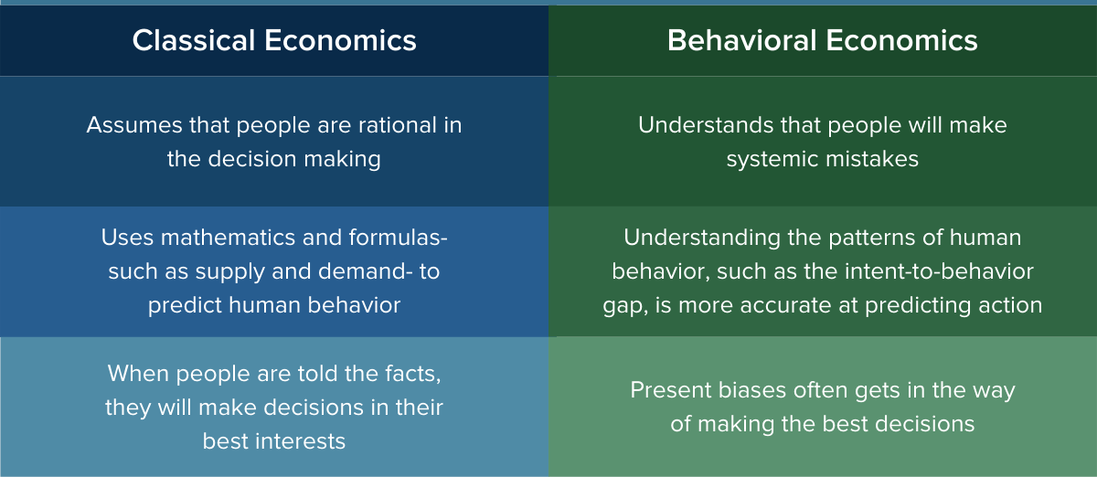
Difference Between Traditional and Behavioral Economics

Slide 27
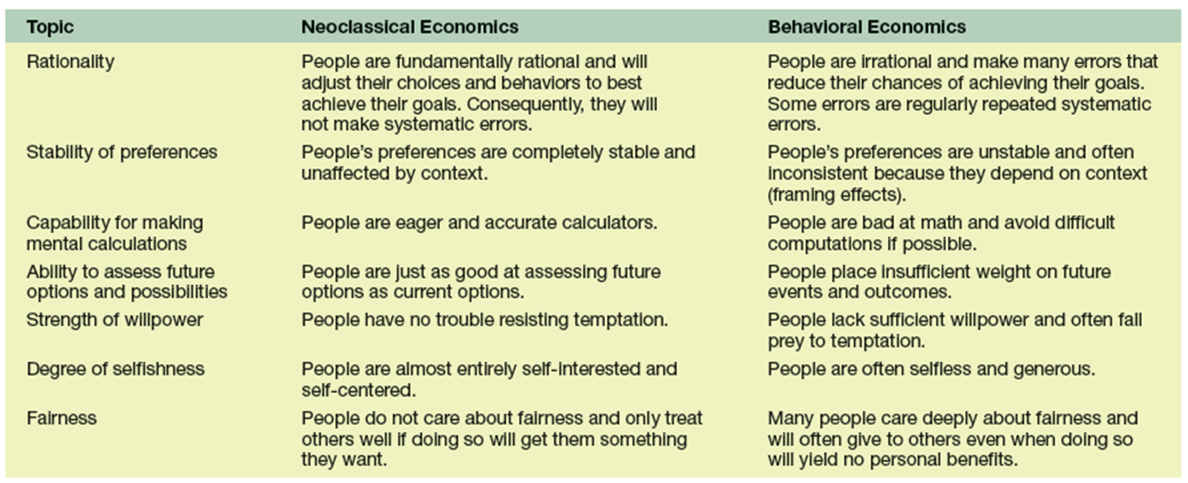

Slide 28
Aspect | Traditional Economics | Neoclassical Economics | Behavioral Economics
Rationality | Individuals are rational. | Individuals are rational with preferences. | Individuals are often irrational.
Key Concept | Invisible Hand, Self-interest. | Marginal Utility, Market Equilibrium. | Bounded Rationality, Heuristics.
Methodology | Qualitative, philosophical. | Mathematical modeling, optimization. | Experimental, interdisciplinary.
Focus | Aggregate markets and production. | Individual decision-making. | Psychological and social influences.
Policy Preference | Minimal government intervention. | Market-based solutions. | Nudges and behavioral interventions.
Criticism | Oversimplified, ignores complexity. | Unrealistic assumptions. | Lacks unified theory, context-specific.

Slide 29

Behavioural economics and social sciences
Psychology - Influence of cognitive biases, emotions, and social influence. Used to Understand consumer behavior and Emotional triggers in marketing.
Sociology – studies the Role of cultural and societal norms in shaping choices. It studies the impact of socioeconomic status on behavioral patterns.
Political Science - Use of nudges in policymaking and the role of framing and heuristics in political campaigns and decisions.
Law – helps in consideration of behavioral insights for crafting regulations and understanding compliance.

Slide 30
Case Study: The Default Effect and Organ Donation Rates
Scenario 1:
Opt-In Systems (e.g., United States, Germany)Citizens must explicitly register to become organ donors. Despite public support for organ donation, participation rates are lower due to inertia and the effort required to make a choice.
Scenario 2
Opt-Out Systems (e.g., Austria, Spain)
Citizens are automatically enrolled as organ donors unless they choose to opt out. Participation rates in these countries are significantly higher because the default option aligns with the desired outcome.

Slide 31
Questions for Discussion:
How do psychological biases like the default effect shape public policies?
Can similar "nudge" strategies be applied in other domains, like retirement savings or healthcare?
Are there ethical implications of using defaults to guide decisions?

Slide 32
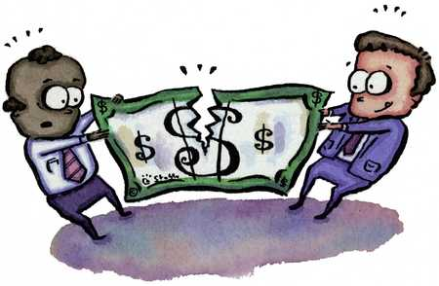
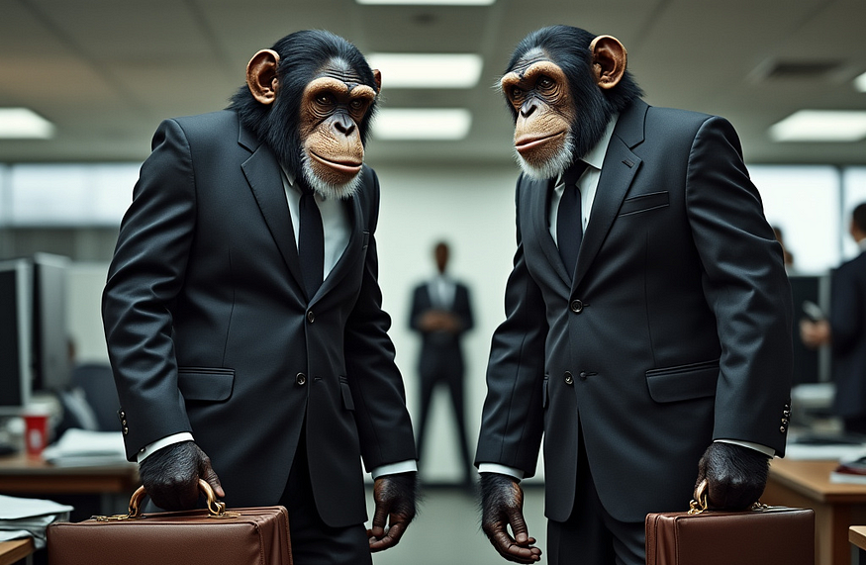
The Ultimatum Game
The ultimatum game is a well-known experiment in behavioral economics that explores how individuals make decisions about fairness and economic rewards.

Slide 33

Money Illusion

Slide 34
Let’s think
Option A - Receiving a 2% yearly pay increase after a year when there has been inflation of 4%.
Option B - Receiving a pay cut of 2% after a year when there has been zero inflation.
Option C - An employee receives a 5% raise in salary, but the inflation rate is 6%.
Option D - A homeowner sells their property for $300,000, which they bought for $200,000 ten years ago.

Slide 35
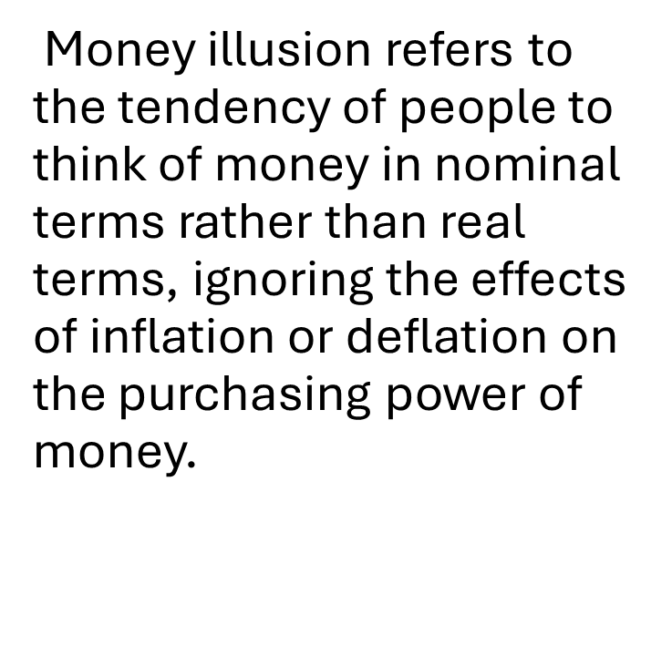
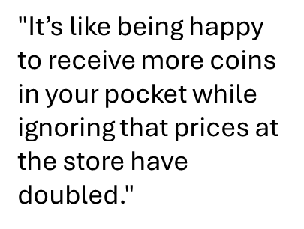

Slide 36
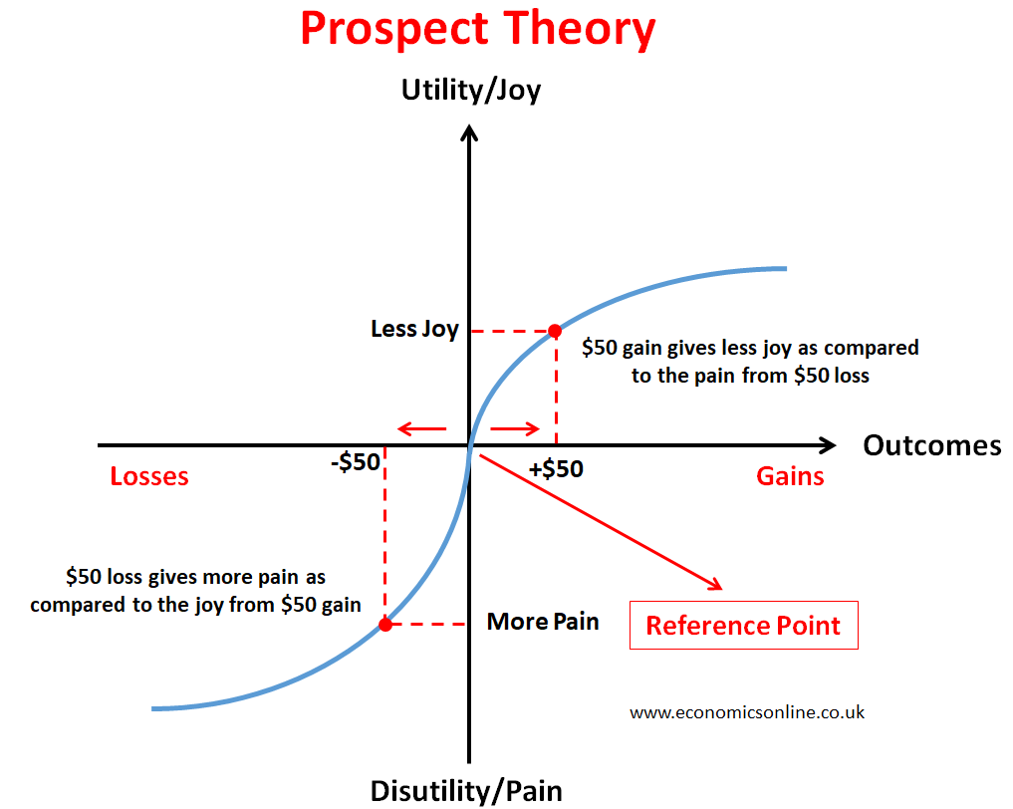
Prospect Theory
Developed by: Daniel Kahneman and Amos Tversky
Key Concept: People value gains and losses differently.
Losses are felt more intensely than equivalent gains (loss aversion)
.People tend to take risks to avoid losses but are risk-averse regarding gains.

Slide 37
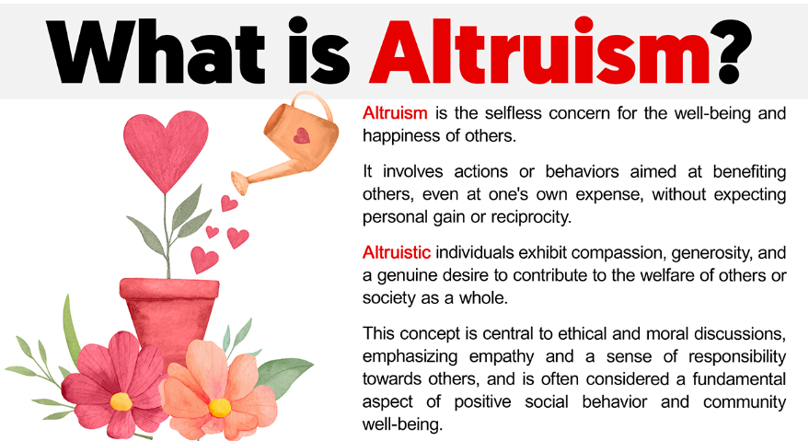

Slide 38
Charitable donations
Charitable donations involve decisions that often defy the traditional economic model of self-interest. Behavioral economics provides insights into why people donate, how donation behavior can be influenced, and the psychological and emotional factors at play.

Slide 39
A few examples..
Example: Studies show that appeals with tangible, specific outcomes (e.g., “Save one child from malaria”) are more effective than abstract statistics (e.g., “Millions are affected by malaria”).
Example: “Join the 10,000 people who have already contributed to this cause.”

Slide 40


